Slide 1
Genetic Algorithm
By: Ashok Basnet

Slide 2
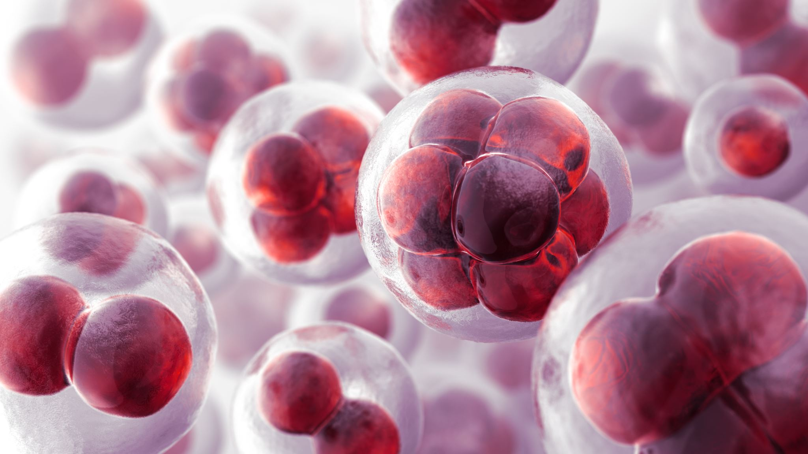
Course Outline
Introduction
Genetic Algorithm
Procedure of Genetic Algorithm
The Working of Genetic Algorithm
The logic Behind Genetic Algorithm
Evolutionary Computing

